Slide 1
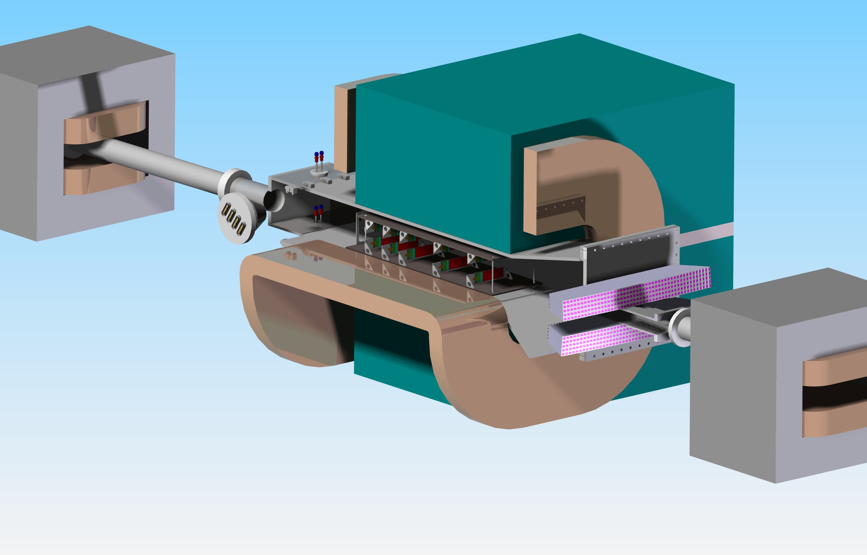
Tracker Design Status
M.Oriunno, SLAC
HPS Collaboration Meeting
JLAB, May 26-27 - 2011

Slide 2
Release - 5/18/2011
Test Run: List of Requirements
Vacuum Chamber | Existing Scattering Chamber Hall B
Vacuum pressure | 10⁻⁶ Torr
Max. radiation Dose | 1X10¹⁴ 2 GeV electrons (~3X10¹³ 1MeV NEQ
Max. Magnetic Field (Dipole field Y) | 0.5 Tesla
Target material and Thickness | 0.125%, Tungsten, 4 um
Target Position (X,Y,Z) from the center of magnet (mm) | 29.87, 0.0, -457.2
Number of active planes | 5 top, 5 bottom
Stereo sensors per plane | 2
Stereo angles L1,L2,L3,L4, L5 (mrad) | (0 / 100 ), (0 / 100 ), (0 / 100 ),(0 / 50 ),(0 / 50 ) mrad (anti-clockwise seen from upstream)
Si dead edges location from the beam (mm) | ±1.5, ±3.0, ±4.5, ±7.5, ±10.5
Z Position (distance from the target along the photon beam) (mm) | 100, 200, 300, 500, 700
X Position (distance from the target) (mm) | 0,0,0,0,0
Y Position (distance from the target) (mm) | Top and Bottom planes move independently along Y. Movement range ±20 mm
Pitch Movement θ | ±20 mrad
Whole Teelscope movement x (mm) | ±20 mm
Whole Teelscope movement yaw φ | ±20 mrad
Max. Material Budget X/Xo | 2%
Installation and maintenance | In Situ (Scattering Chamber fixed in the magnet)
Si Bias Voltag, Nominal - Maximum | 150 V – 500 V
Operating temperature | 0º C
Front End Readout | APV25
APV heat Load | 2.31 mW / channel x 128 channels = 395 mW
Numberof Chip per sensor | 5
Heat Load per hybrid | 2.0 W
Heat Load per sensor (Leakage Current) | 100 mW
Heat load per sensor Radiative | 1.0 W
Physics requirements
Eng. requirements
Functional
Environment
Geometry
Det.Operation

Slide 3
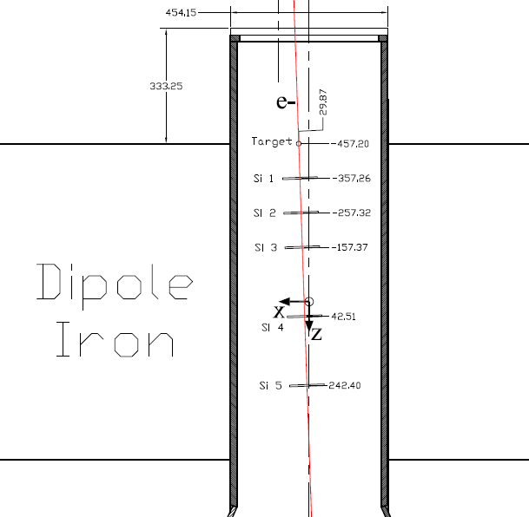
Target at Z = -457.2 mm
Si Planes along the photon beam
Dist. from target
100 mm (0º/100º)
100 mm (0º/100º)
100 mm (0º/100º)
200 mm (0º/50º)
200 mm (0º/50º)

Slide 4
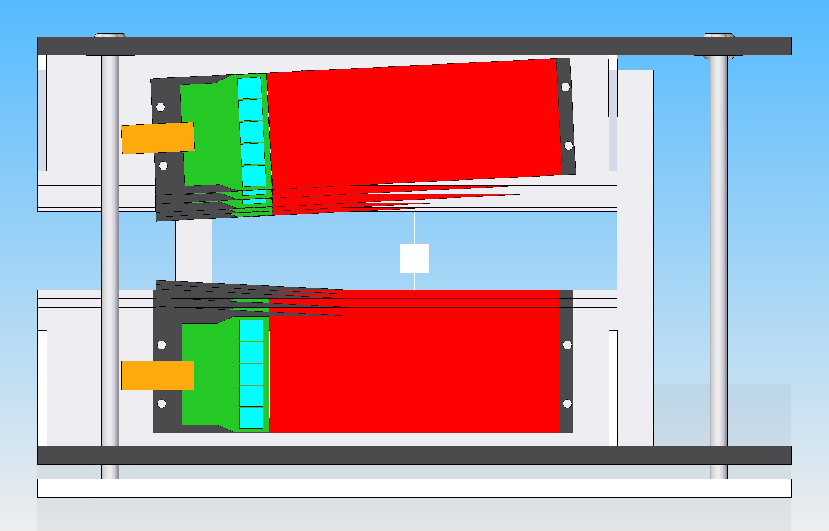
Tracker Design
920 mm
±50 mrad
±100 mrad
150 mm

Slide 5
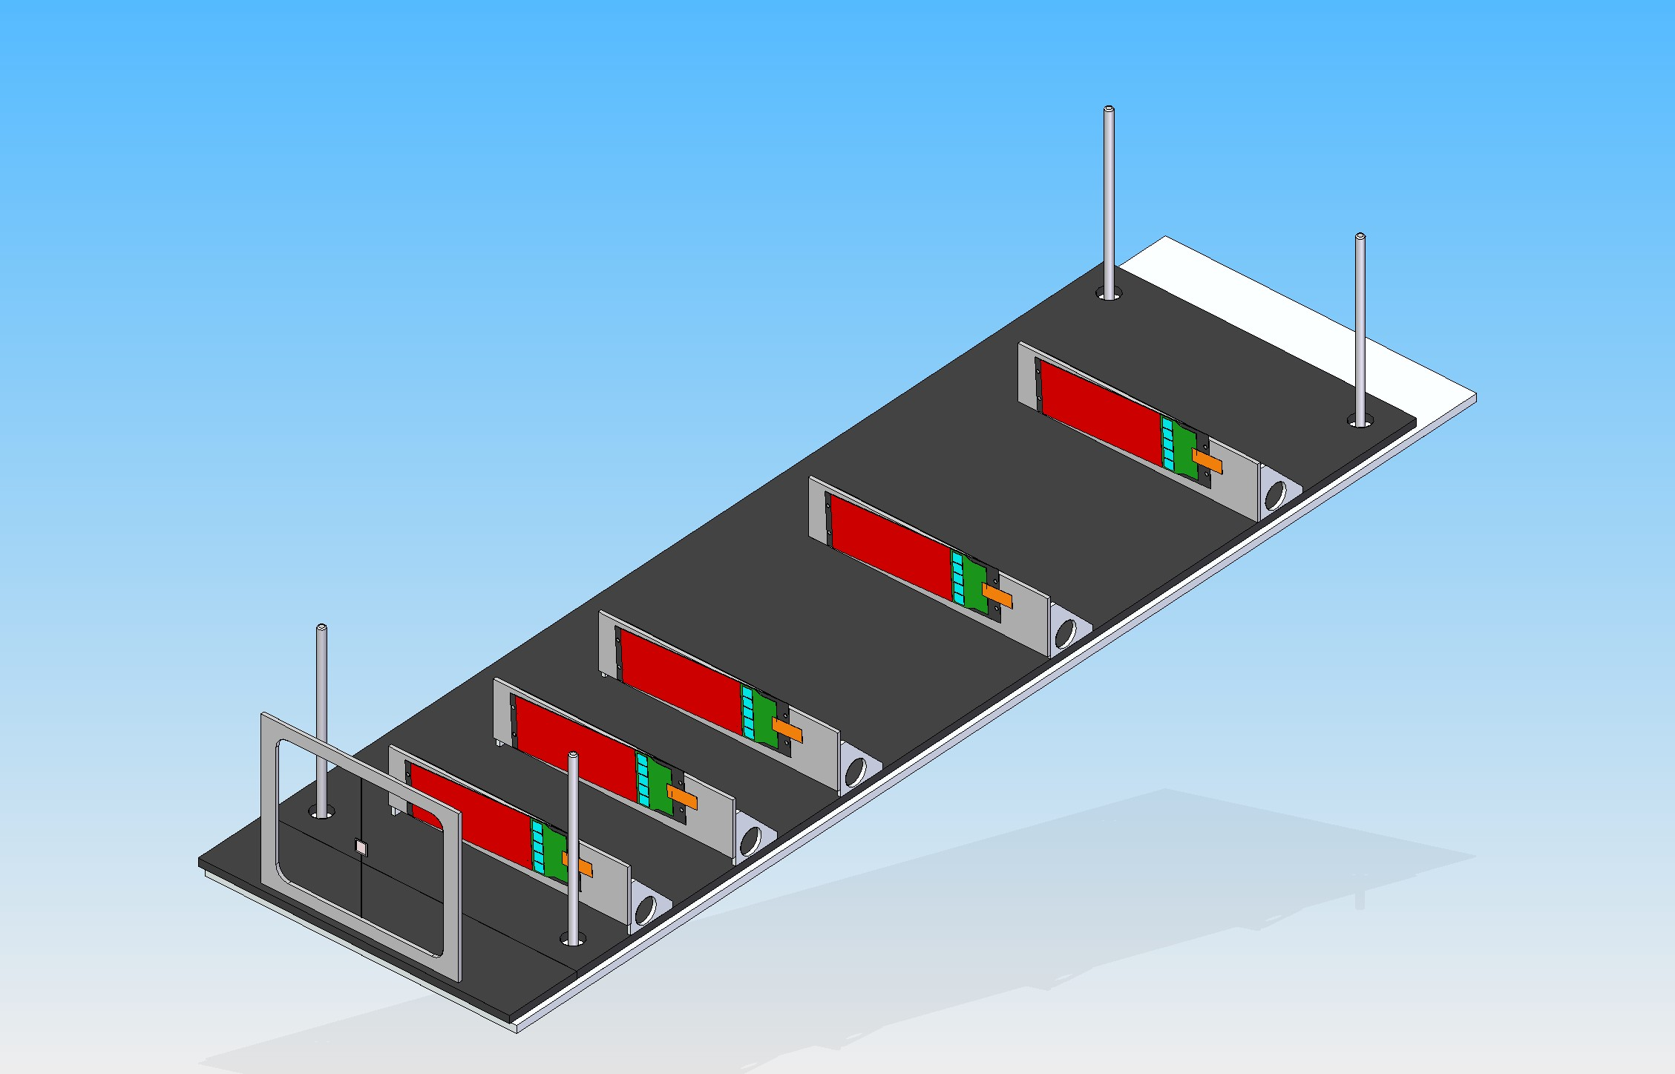
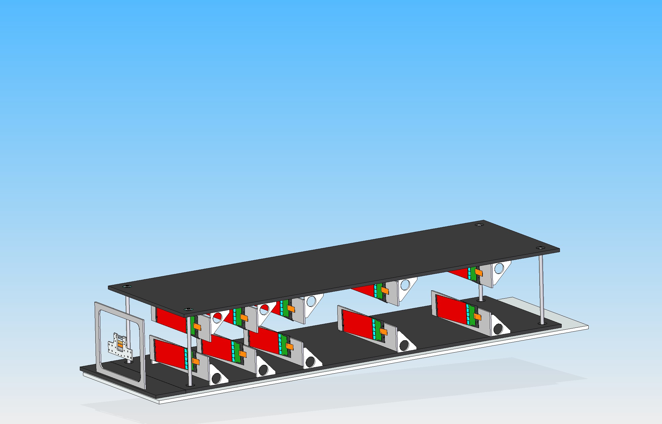
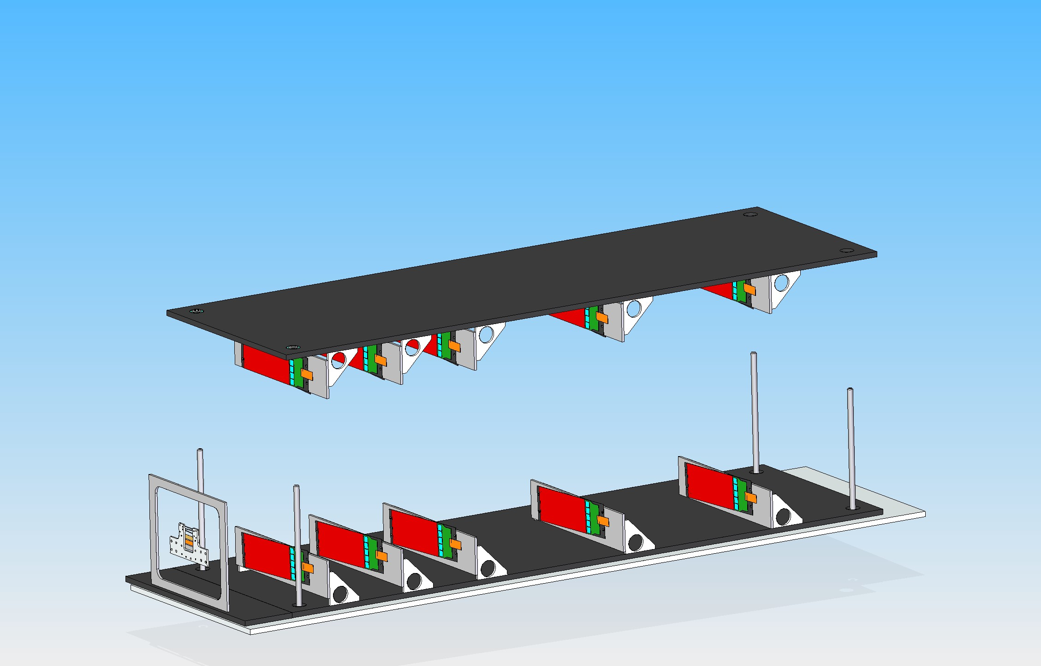
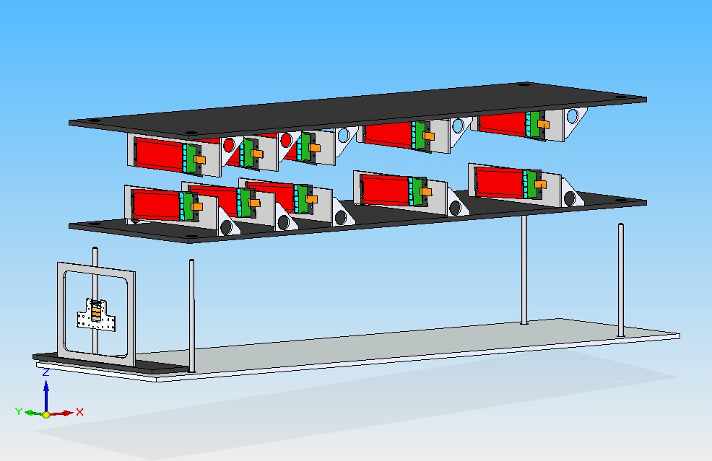
Tracker Design

Slide 6
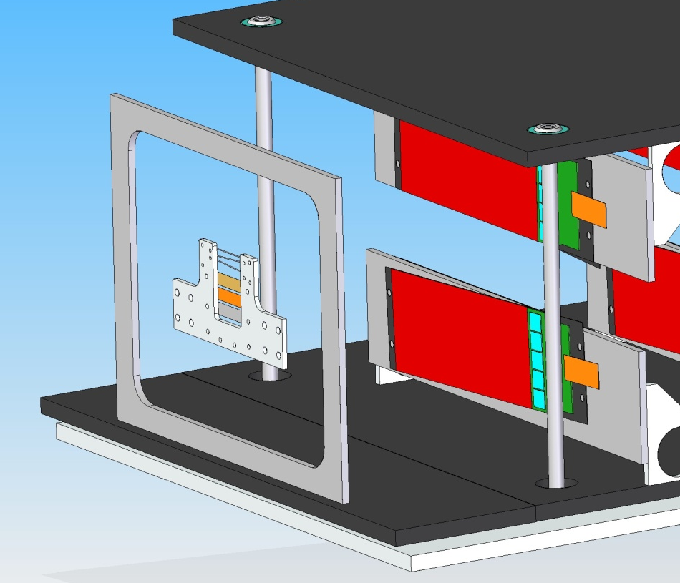
Y ± 20 mm
Y ± 20 mm
Top Plane
Target
Linear Guides
θ ± 20 mrad
Y ± 20 mm
Bottom Plane
Y ± 20 mm
260 mm
920 mm

Slide 7
Tracker Motion
Vacuum Chamber
Actuator
Actuator
beamline
Compression Springs
Vacuum Chamber

Slide 8
Alignment & Positioning
Motion with 5 independent axis : 2 per half silicon planes, 1 for the target
Additional actuators for the alignment in the horizontal plane (X, θ) ?
Bam position information in the scattering chamber : reference system, precision ?
Maximum excursion of the beam due to magnetic filed error, beam loss accident
Does the beam move in X and Y ?
Physical edge of the detector at 1.5 mm, additional clearance is needed ? Beam stability or loss

Slide 9
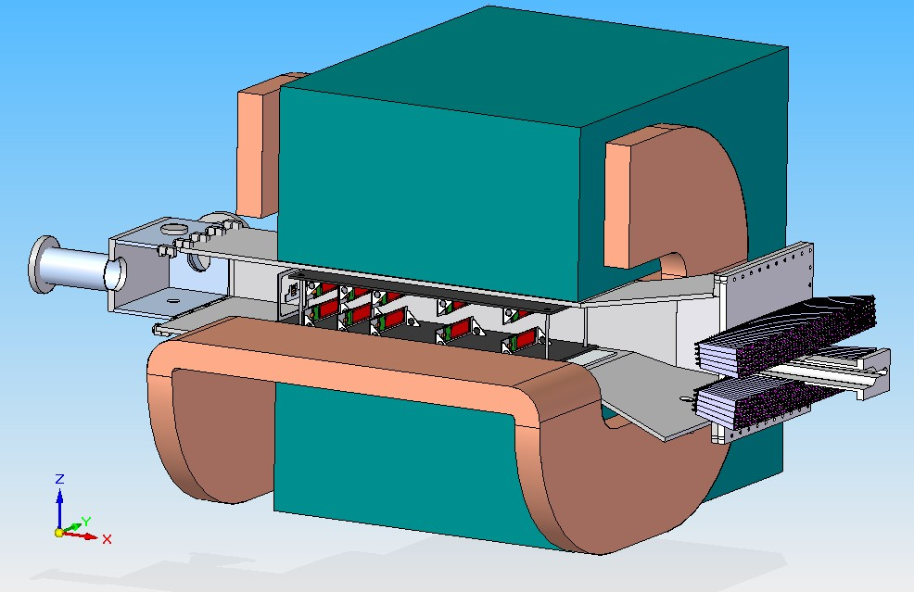
Test Run: Experimental Layout

Slide 10
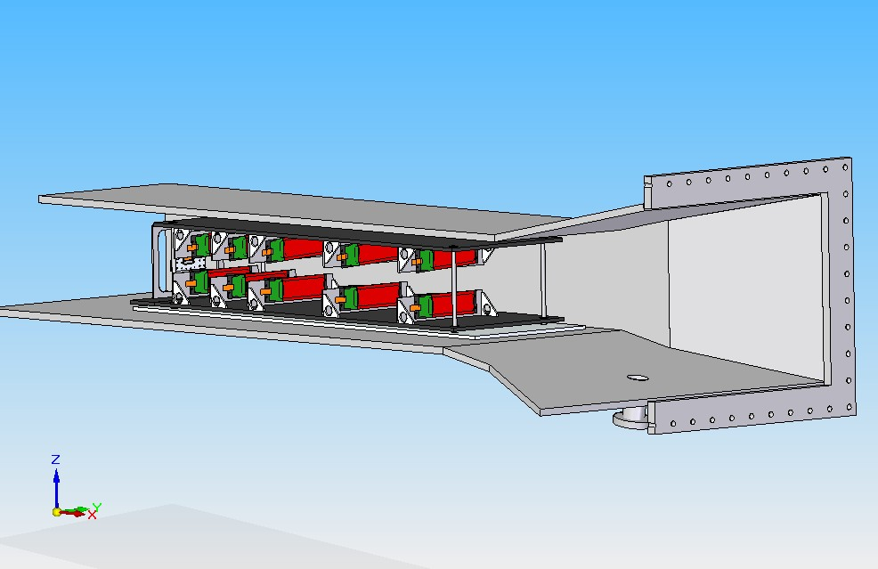
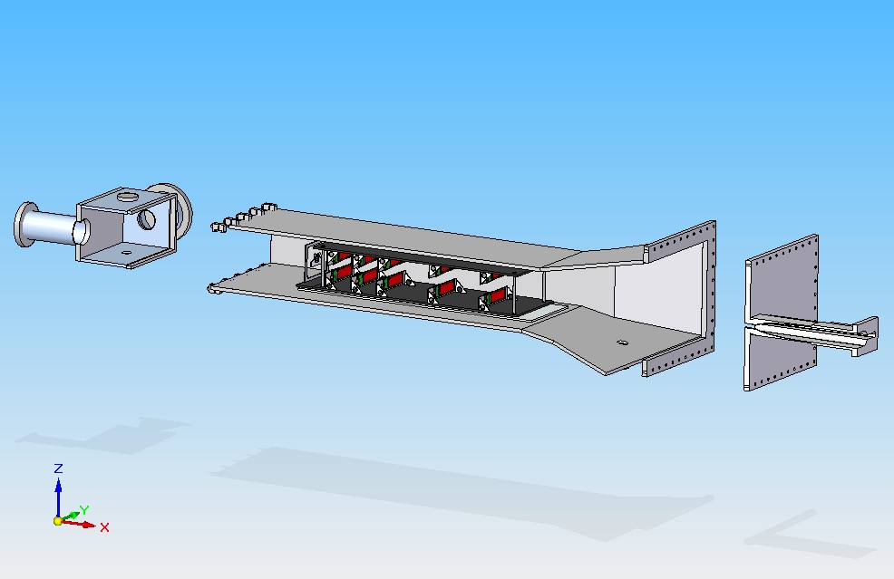
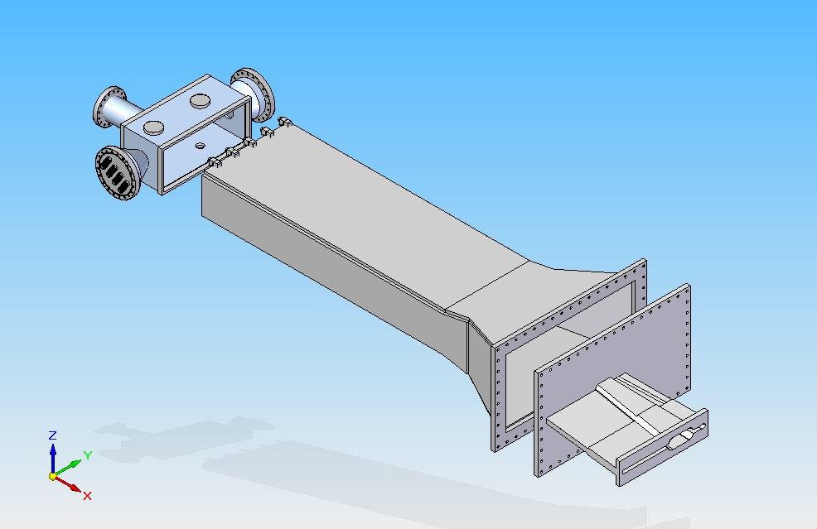
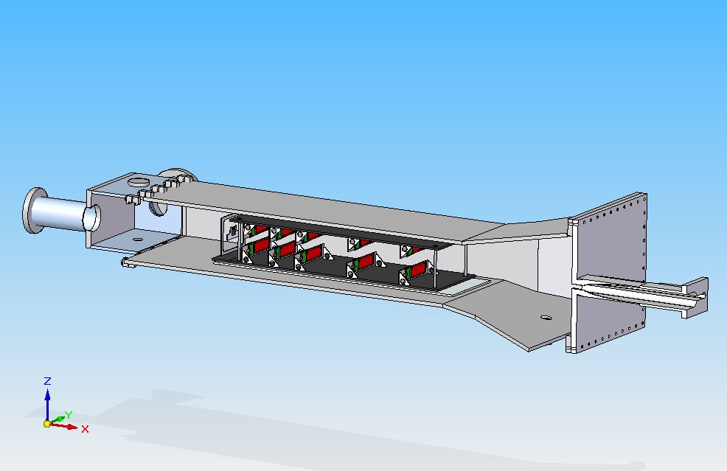
Integration with vacuum chamber

Slide 11
List of Cables/Pipes
x 10 Hybrids | Qt.y | AWG | D conductor (mm) | D total (mmm) | Area (mm2)
Signals | 140 | 26 | 0.405 | 1 | 109.96
Power | 16 | 22 | 0.644 | 1.3 | 21.24
HV | 20 | 24 | 0.511 | 1.16 | 21.14
 |  |  |  | Total | 152.33
 |  |  |  | Total with 30% packaging factor | 198.03
Cooling Tube | 4 |  | 6
Motion | 4 |  | 6

Slide 12
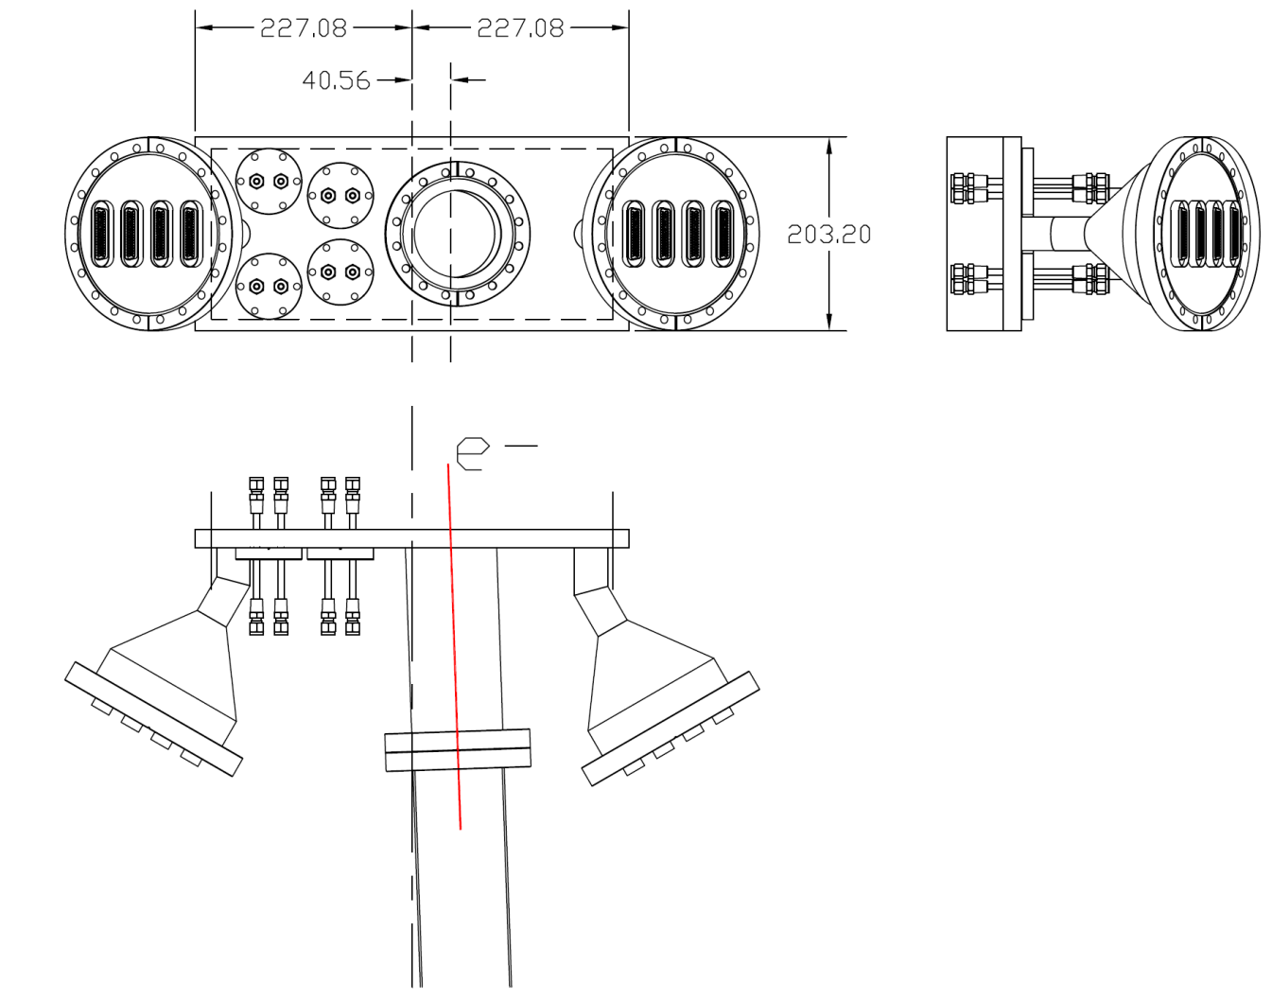
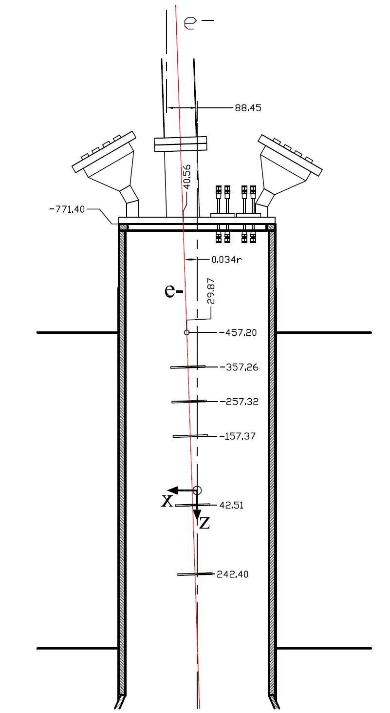
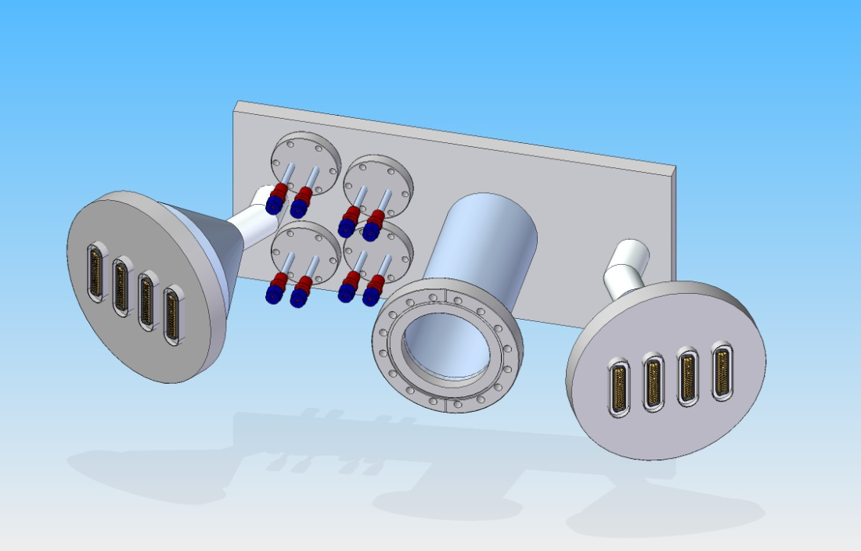

Slide 13
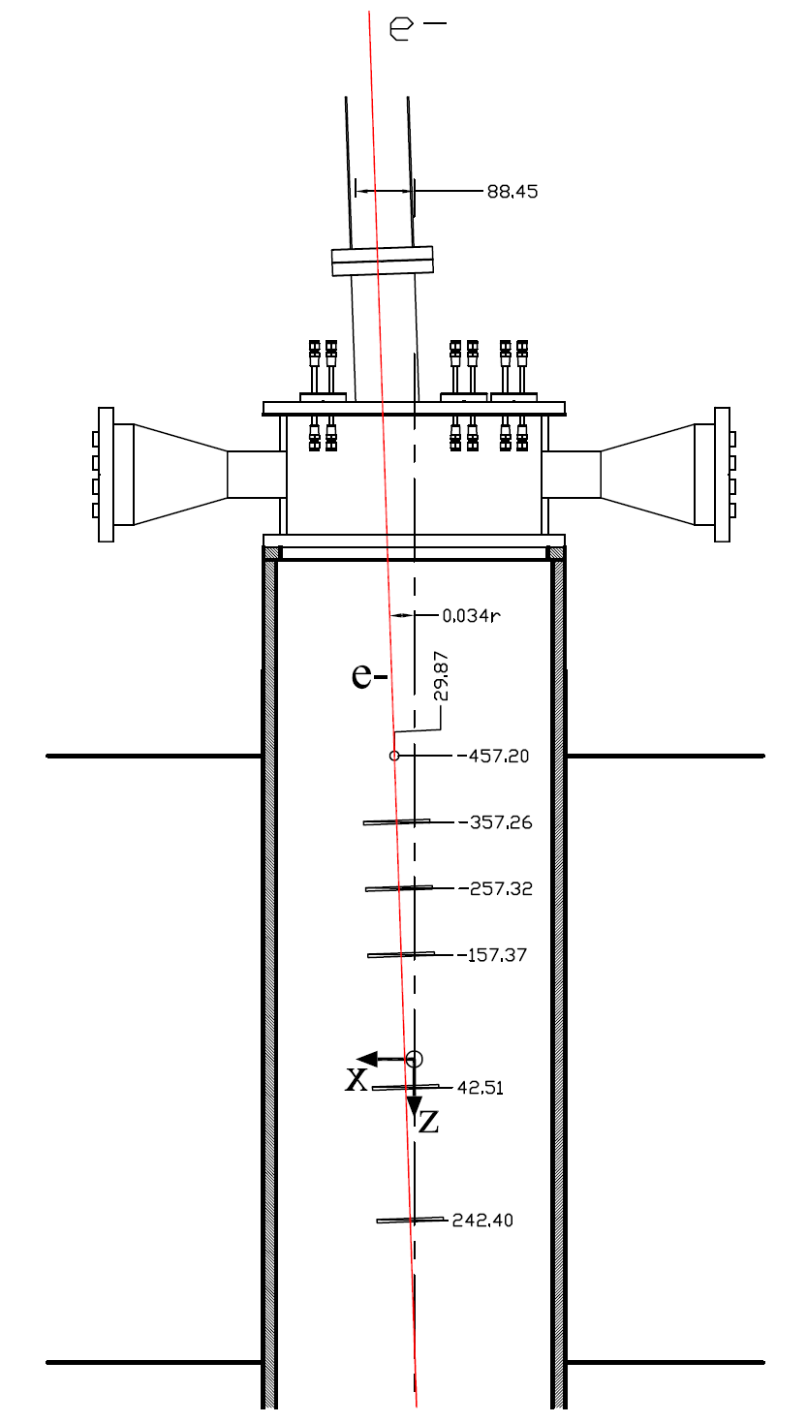
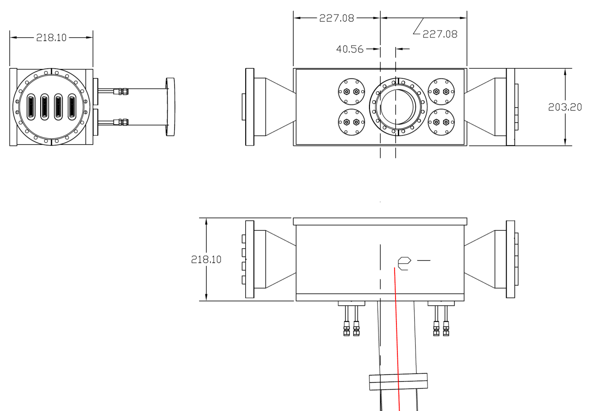
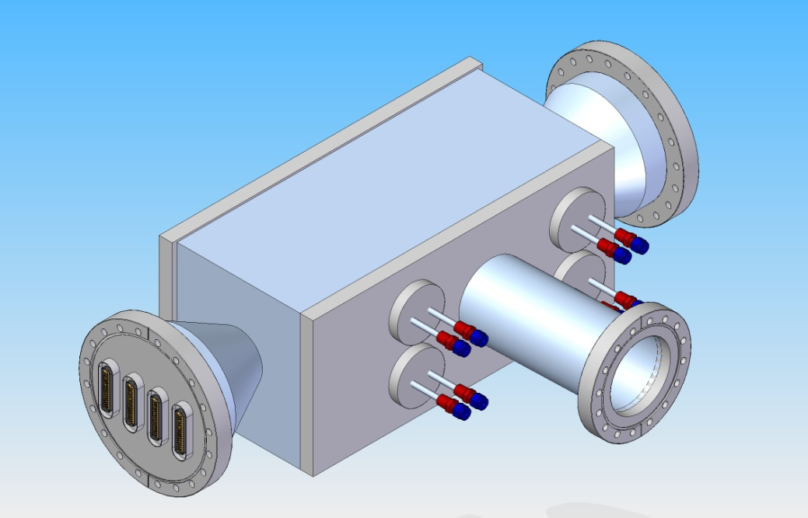

Slide 14
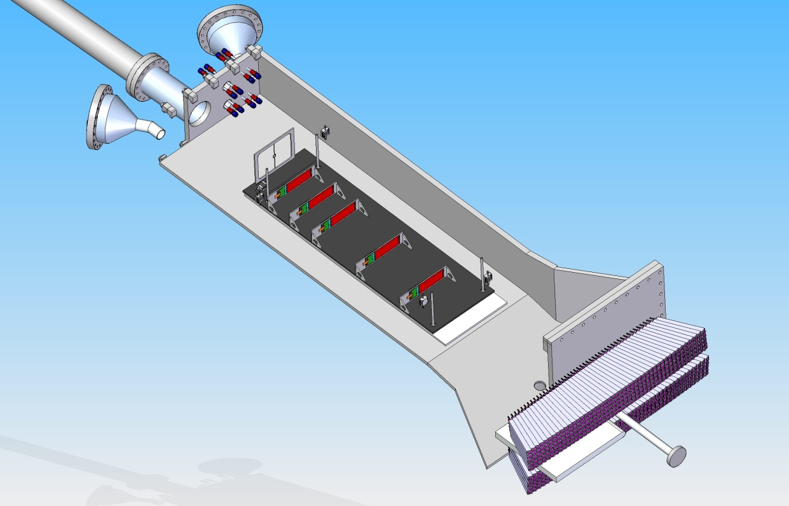
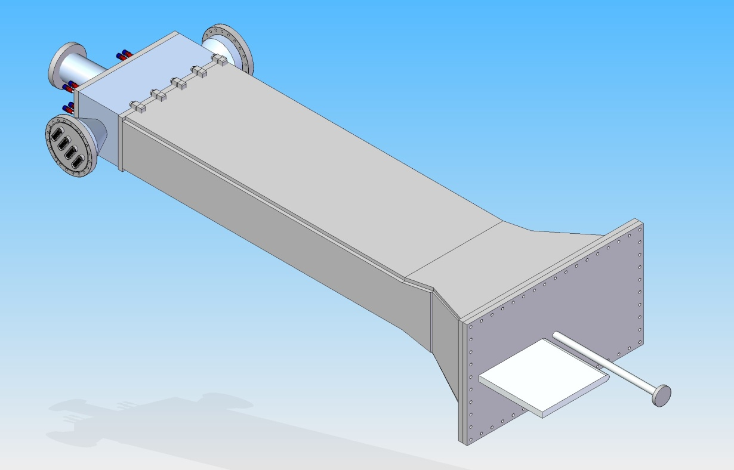

Slide 15
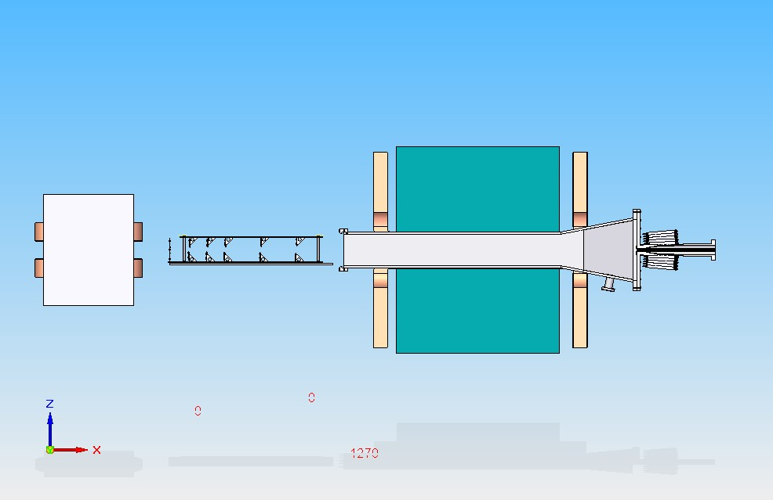
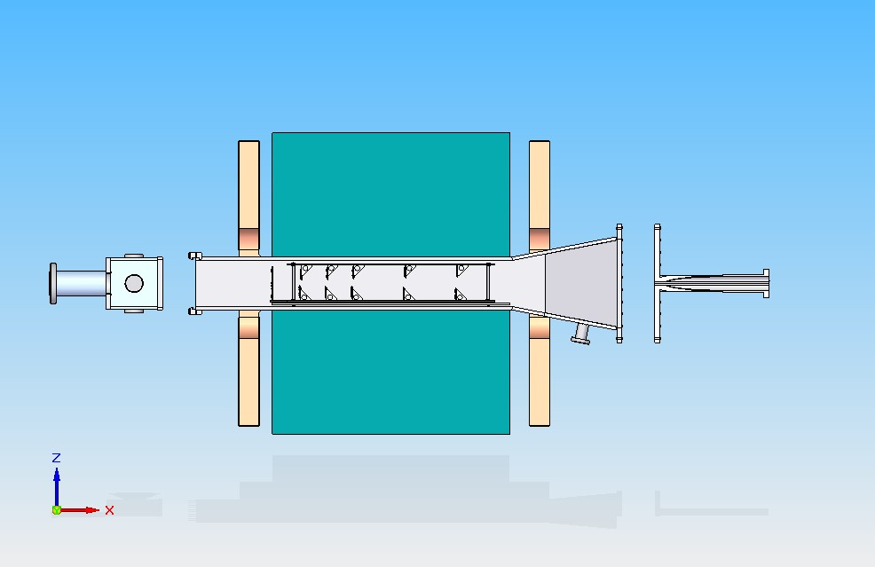
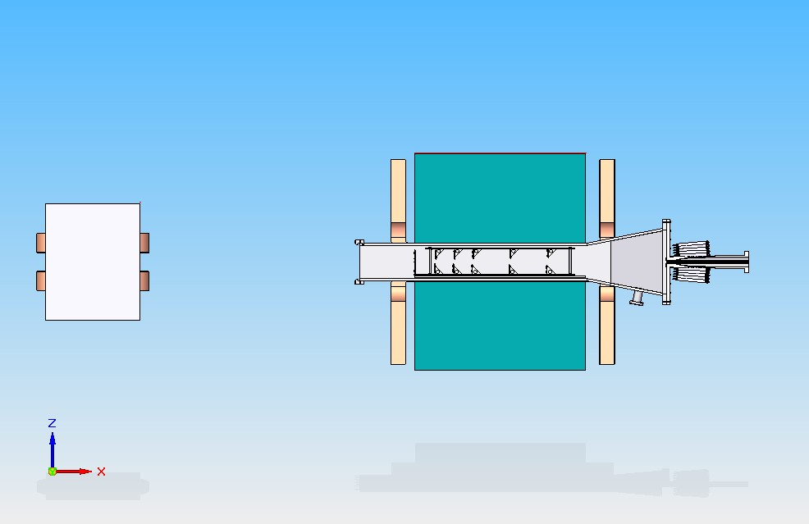
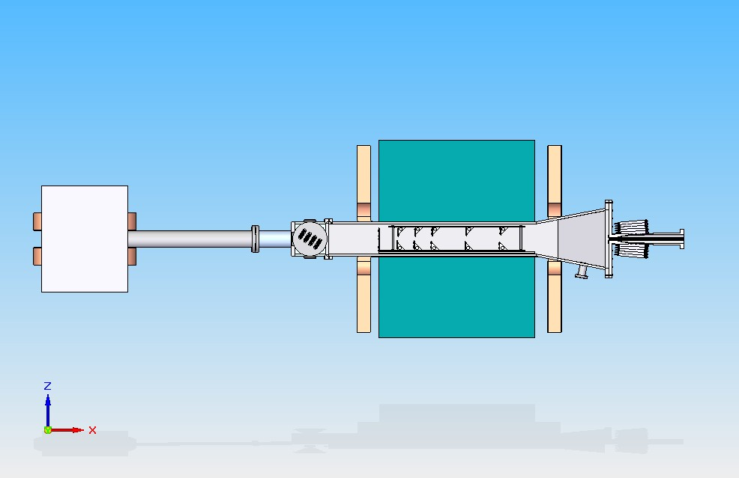
Installation/Maintenance

Slide 16
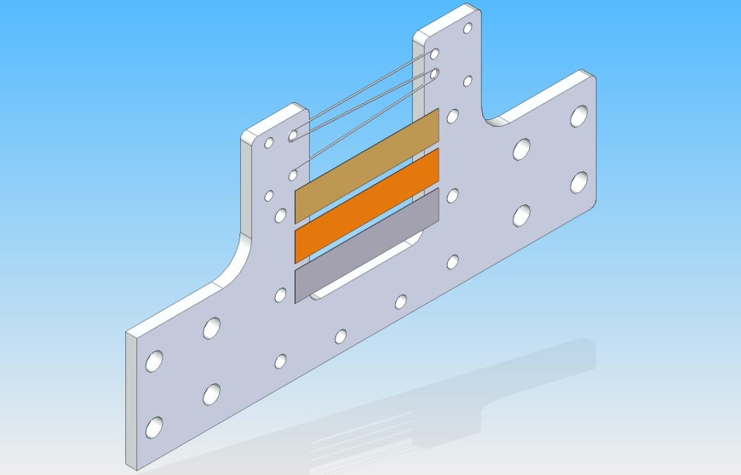
Target Design, stationary – not spinning
Wire scanner 14 um, Tungsten
Target Foils 10 um
Vertical movement
± 100 mm
Target Holder
80 mm

Slide 17
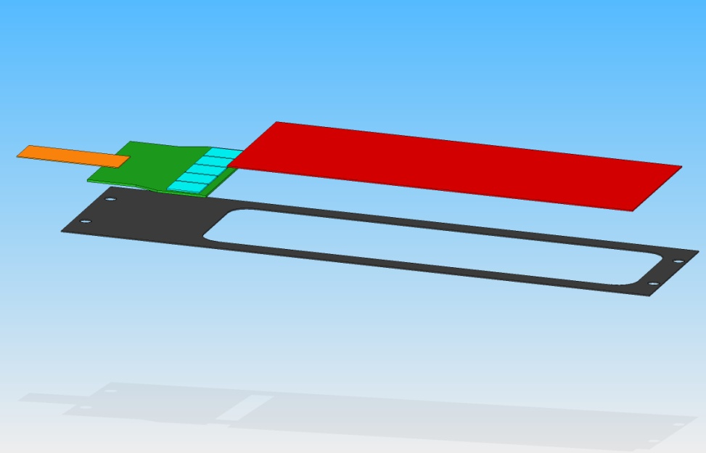
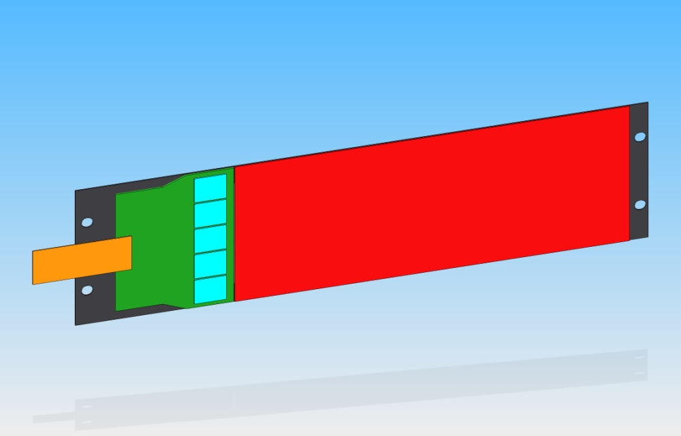
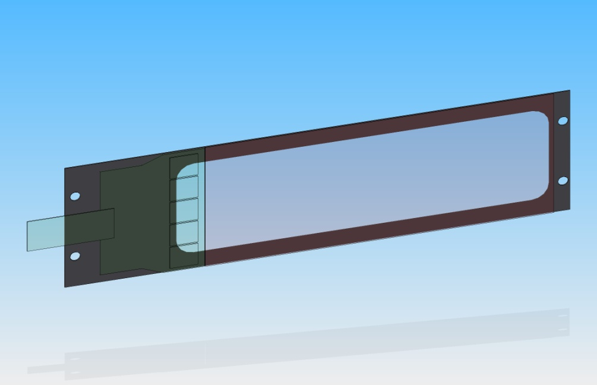
The Detector Module
Heat
100 mm
40 mm
Heat
Cooling
Frame Support with High Conductivity Carbon Fibre
K13UD available at FNAL
Cooling on the back plane of the Hybrid :
Cold plate connected to an external chiller
Started the construction of a Thermo-Mechanical mockup
CF frame

Slide 18
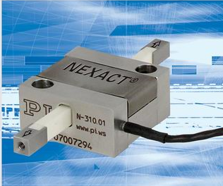
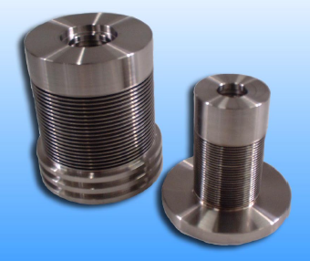
Motion
Environment req.s :
High Magnetic Field 5’000 gauss
Vacuum 10⁻⁶ torr
Min. 5 independent Degree of Freedom (2 x 2 Si plane, 1 target)
Standard Stepper motors do not operate in magnetic field
Too many d.o.f. to place them outside the fringe field
Piezo-Motors:
Excellent performances in vacuum and mag. field
Asked P&I for a quote for 4 motors + controllers ~ $50’000
Welded bellow actuators
Stroke length
Repeatability
Pneumatic or hydraulic

Slide 19
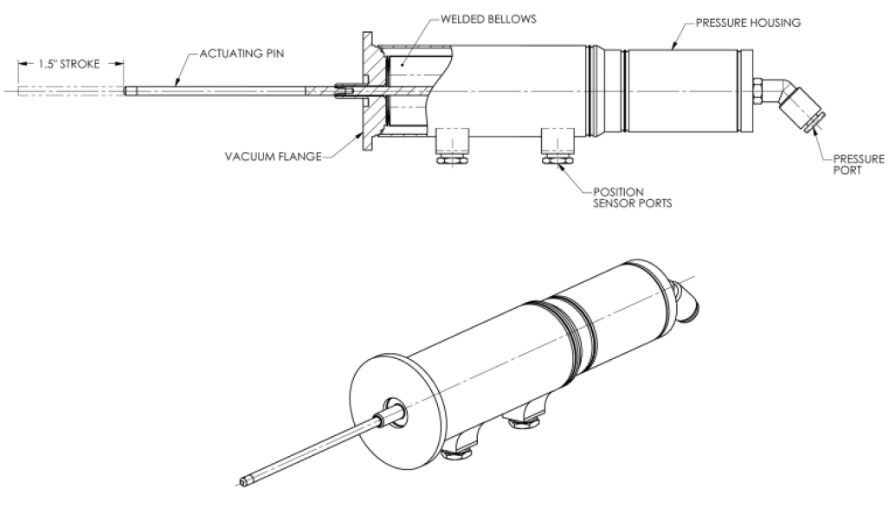
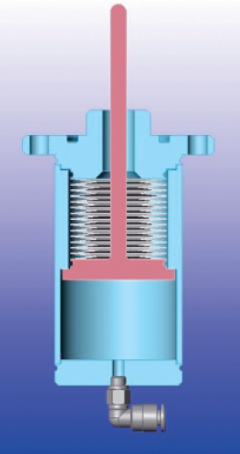
Bellow actuator
Hydraulic operated (incompressibility)
Need to make small R&D to validate the precision and resolution required
(10um and 50um)
Concerns on thermal stability
Vacuum Chamber
Feed-through

Slide 20
Open questions….for this meeting
Confirm the final location of the tracker in the magnet
Alignment strategy with beamline
Number of remotely controlled d.o.f. / actuators
Protection against beam loss accidents

